Slide 1
Euler Paths and Circuits
（欧拉路径与欧拉回路）

Slide 2
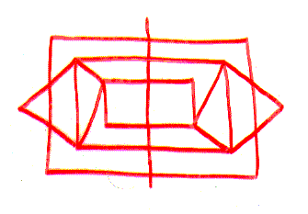

Problem
Can I draw the figure in one continuous trace with no line being drawn twice?
School of Computer Science, BUPT

Slide 3
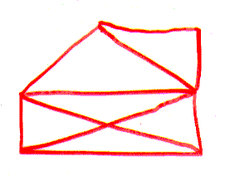

Problem
How about this one?
School of Computer Science, BUPT

Slide 4
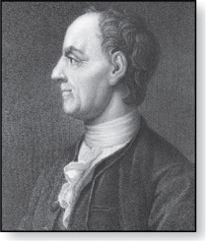
Königsberg Bridge problem
Leonard Euler (1707-1783)
The residents of Königsberg, Germany, wondered if it was possible to take a walking tour of the town that crossed each of the seven bridges over the Pregel River exactly once.
  Leonard Euler 1736 (father of graph theory)
School of Computer Science, BUPT

Slide 5
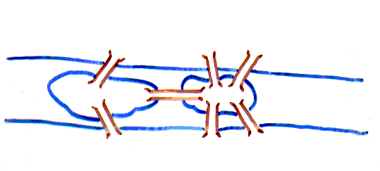
Königsberg Bridge problem
Picture only what is essential to the problem.
School of Computer Science, BUPT

Slide 6
Königsberg Bridge problem
Is it possible to start at some node and take a walk that uses each edge exactly once, and ends at the starting node?
School of Computer Science, BUPT

Slide 7
Königsberg Bridge problem
You can redraw the original picture as long as for every edge between nodes i and j in the original you put an edge between nodes i and j in the redrawn version (and you put no other edges in the redrawn version)
1
2
2
3
4
1
3
4
School of Computer Science, BUPT

Slide 8
Can you see why?
Euler
  Has no tour that uses each edge exactly once.
  (Even if we allow the walk to start and finish in different places.)
School of Computer Science, BUPT

Slide 9
Eulerian graph（欧拉图）
An Euler circuit in a graph G is a simple circuit containing every edge of G.
An Euler path in G is a simple path containing every edge of G.
A walk in a graph is called an Euler tour if it starts and ends in the same place and uses each edge exactly once.
A walk in a graph is called an Euler trail if it uses each edge exactly once.
If a graph has an Euler tour, it is said to be an Eulerian graph.
School of Computer Science, BUPT

Slide 10
Eulerian graph
School of Computer Science, BUPT

Slide 11
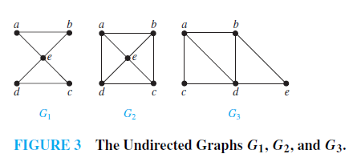
Example 1
Which of the undirected graphs in Figure 3 have an Euler circuit? Of those that do not, which have an Euler path?
School of Computer Science, BUPT

Slide 12
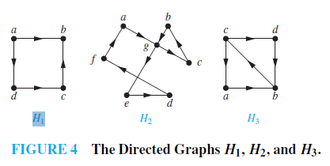
Example 2
Which of the directed graphs in Figure 4 have an Euler circuit? Of those that do not, which have an Euler path?
School of Computer Science, BUPT

Slide 13
The problem in our language
Show that is not Eulerian.
In fact, it contains no Euler trail.
School of Computer Science, BUPT

Slide 14

Theorem
1. A connected graph G is Eulerian
G is connected and has no vertices of odd degree
2. A connected graph G has an Euler trail from node a to some other node b
G is connected and a ≠ b are the only two nodes of odd degree
School of Computer Science, BUPT

Slide 15
Proof of ⇓
Assume G has an Euler trail T from node a to node b (a and b not necessarily distinct).
For every node besides a and b, T uses an edge to exit for each edge it uses to enter. Thus, the degree of the node is even.
1. If a = b, then a also has even degree.
2. If a ≠ b, then a and b both have odd degree.
School of Computer Science, BUPT

Slide 16
Proof of ⇑
Assume G is connected. If there are no odd-degree nodes, pick any a = b.
If there are two odd-degree nodes, call these nodes a and b.
Start at a. Take a walk w₁ until you get stuck. You must be at b.
a
v
b
Incorporate this walk from v into w₁.
School of Computer Science, BUPT

Slide 17
Proof of ⇑
If no vertex along w₁ has an unused edge, we are done.
Otherwise, call this vertex v. Walk from v until you get stuck. You must be back at v.
a
v
b
Incorporate this walk from v into w₁.
School of Computer Science, BUPT

Slide 18
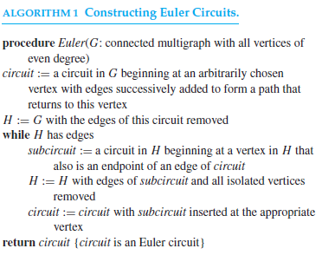
Algorithm 1
P732
School of Computer Science, BUPT

Slide 19
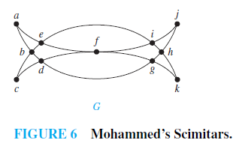
Example 3
Draw a picture in a continuous motion without lifting a pencil so that no part of the picture is retraced.
School of Computer Science, BUPT

Slide 20
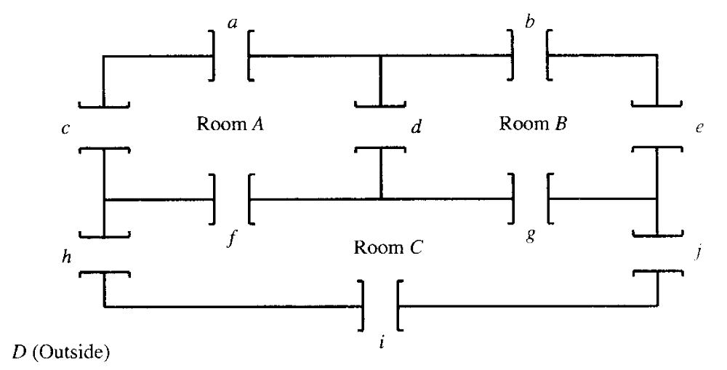
Example
The problem is this: Is it possible to begin in a room or outside and take a walk that goes through each door exactly once?
School of Computer Science, BUPT

Slide 21
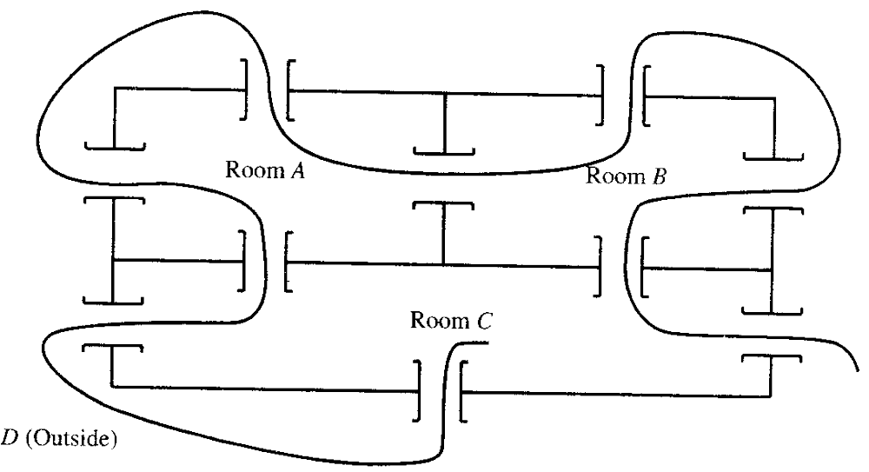
Example
School of Computer Science, BUPT

Slide 22

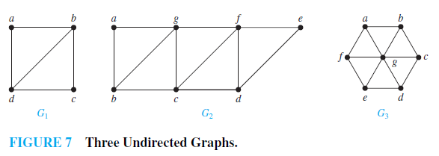
多选题
1分
Which graphs shown in Figure 7 have an Euler path?
A
G₁
B
G₂
C
G₃
提交
School of Computer Science, BUPT

Slide 23
APPLICATIONS OF EULER PATHS AND CIRCUITS
each street in a neighborhood
each road in a transportation network
each connection in a utility grid
each link in a communications network
Chinese postman problem in honor of Guan Meigu，who posed it in 1962.
School of Computer Science, BUPT

Slide 24
Hamilton Paths and Circuits（哈密顿路径与回路）

Slide 25
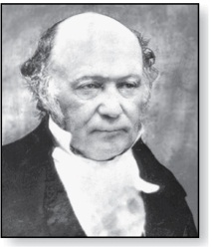
Hamiltonian Graph
（哈密顿图）
William Rowan Hamilton (1805- 1865)
A graph has a Hamiltonian tour if there is a tour that visits every vertex exactly once (and returns to its starting point).
A graph with a Hamiltonian tour is called a Hamiltonian graph.
A Hamiltonian path is a path that contains each vertex exactly once.
A Hamilton circuit is a circuit that traverses each vertex in G exactly once.
A Hamilton path is a path that traverses each vertex in G exactly once
School of Computer Science, BUPT

Slide 26
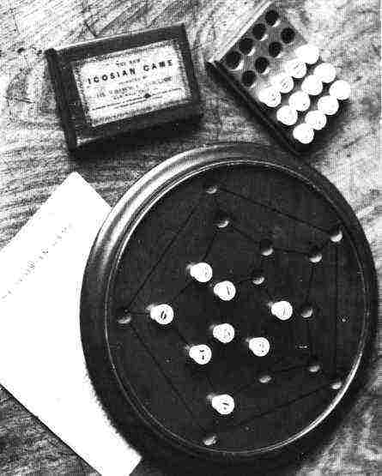
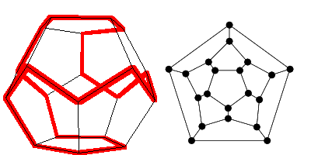
Round-the-World Puzzle
Can we traverse all the vertices of a dodecahedron, visiting each once?`
Equivalent
graph
Dodecahedron puzzle
Pegboard version
School of Computer Science, BUPT

Slide 27
Is it Hamiltonian?
A graph of the vertices of a dodecahedron.
Yes.
School of Computer Science, BUPT

Slide 28
Euler tour
Hamiltonian tour
Left one has a Hamiltonian path, but not a Hamiltonian tour.
Right one has an Euler tour, but no Hamiltonian tour.
School of Computer Science, BUPT

Slide 29
Question?
Given a graph, what is a fast way to determine if it is Hamiltonian? Can we give a characterization of Hamiltonian graphs that is as simple as the one for Eulerian graphs?
School of Computer Science, BUPT

Slide 30
No one knows
There is probably no nice characterization of Hamiltonian graphs the way there was with Eulerian graphs.
  Deciding if a graph is Hamiltonian is NP−complete.
    This means, if an algorithm for solving it in polynomial time were found, it could be used to solve all NP problems in polynomial time.
School of Computer Science, BUPT

Slide 31
Partial result
We now state some partial answers that say if a graph G has "enough" edges, a Hamiltonian circuit can be found.
These are again existence statements; no method for constructing a Hamiltonian circuit is given.
School of Computer Science, BUPT

Slide 32
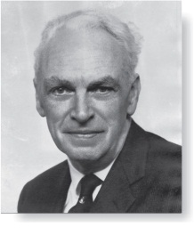
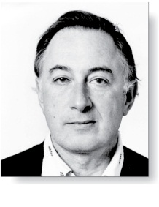
Theorem 3,4
Øysten Ore
(1899-1968)
ORE’S THEOREM: If G is a simple graph with n vertices with n ≥ 3 such that deg(u) + deg(v) ≥ n for every pair of nonadjacent vertices u and v in G, then G has a Hamilton circuit.
  DIRAC’S THEOREM: If G is a simple graph with n vertices with n ≥ 3 such that the degree of every vertex in G is at least n/2, then G has a Hamilton circuit.
Gabriel Andrew Dirac
(1925-1984)
School of Computer Science, BUPT

Slide 33
Theorem
Let the number of edges of G be m.
Then G has a Hamiltonian circuit if
  m≥(n²-3n-6)/2.
School of Computer Science, BUPT

Slide 34
Proof
Suppose that u and v are any two vertices of G that are not adjacent.
  We write deg(u) for the degree of u.
Let H be the graph produced by eliminating u and v from G along with any edges that have u or v as end points.
Then H has n-2 vertices and m-deg(u)-deg(v) edges (one fewer edge would have been removed if u and v had been adjacent).
School of Computer Science, BUPT

Slide 35
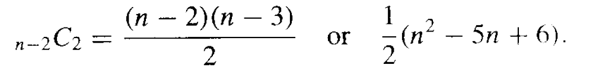
Proof
The maximum number of edges that H could possibly have is _{n-2}C₂.This happens when there is an edge connecting every distinct pair of vertices. Thus the number of edges of H is at most
School of Computer Science, BUPT

Slide 36
Proof
So
  m - deg(u) - deg(v) ≤ (n² - 5n + 6)/2.
Therefore
  deg(u)+deg(v) ≥ m - (n² - 5n + 6)/2.
By the hypothesis of the theorem,
  deg(u)+deg(v) ≥ (n²-3n-6)/2 - (n²-5n+6)/2 = n.
Thus the result follows from Theorem 3.
School of Computer Science, BUPT

Slide 37
Note
The converses of Theorems 3 and 4 given above are not true; that is, the conditions given are sufficient, but not necessary, for the conclusion.
School of Computer Science, BUPT

Slide 38
Applications of Hamilton Circuits
each road intersection in a city
each place pipelines intersect in a utility grid
each node in a communications network.
The famous traveling salesperson problem or TSP
the edges may have weights representing distance, cost, and the like. The problem is then to find a Hamiltonian circuit (or path) for which the total sum of weights in the path is a minimum.
School of Computer Science, BUPT

Slide 39
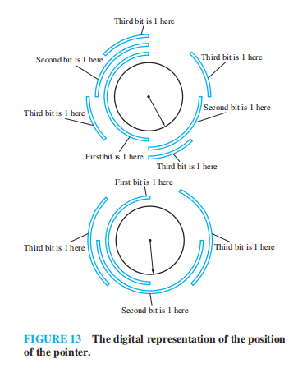
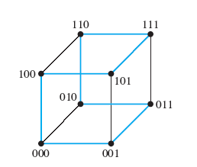
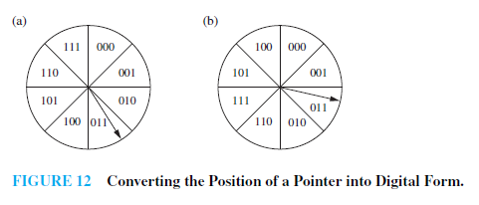
Gray Codes
A Gray code is a labeling of the arcs of the circle such that adjacent arcs are labeled with bit strings that differ in exactly one bit.
P737-738
School of Computer Science, BUPT

Slide 40
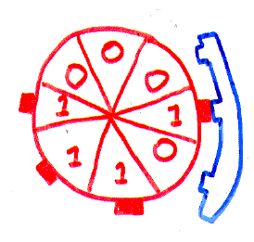
Rotating memory drum （旋转鼓轮）
“Modern” application:memory wheel
Address decoder
School of Computer Science, BUPT

Slide 41
Rotating memory drum
Is there a memory wheel with 16 bits in which all 4-bit patterns occur?
Is there a memory wheel with 2^{n} bits in which all n-bit patterns occur?
School of Computer Science, BUPT

Slide 42
000
100
001
010
1
0
0
1
0
101
1
1
0
110
011
111
There is an arrow from node a to node b if the last two bits in a equal the first two bits in b.
There is a 1-1 correspondence between Hamiltonian tours of this graph and memory wheels with 8 bits.
School of Computer Science, BUPT

Slide 43
Hamiltonian graph?
0000
0001
0011
0010
0111
0110
0101
0100
1011
1010
1001
1000
1101
1100
1110
1111
School of Computer Science, BUPT

Slide 44
Different representation
Perhaps a different graph can represent the same problem.
Hint: It’s better to be looking for Eulerian tours than Hamiltonian tours.
School of Computer Science, BUPT

Slide 45
Idea
Instead of having the nodes be the 3-bit patterns, and putting an edge between patterns with a 2-bit overlap,……
Have the nodes be the 2-bit overlap and the edges the 3-bit pattern.
abc
ab
bc
bcd
cd
School of Computer Science, BUPT

Slide 46
The result is
Every Euler tour corresponds to a memory wheel.
000
00
001
100
010
01
10
101
011
110
11
111
School of Computer Science, BUPT

Slide 47
0000
000
1000
0001
100
1001
001
0100
0010
010
0
1
1
1100
1010
0101
0011
1
1
1
1
101
0
0
1101
1011
0
0
110
0110
011
1
0
0
0
1
111
1110
0111
1111
School of Computer Science, BUPT

Slide 48
Theorem
For every n, there exists a memory wheel of size 2^{n} that has all n-bit patterns.
Proof
  There are 2 edges in and 2 edges out of every vertex. Graph is connected – can find path from any a to any b.Thus the graph is Eulerian. Every Euler tour corresponds to a memory wheel.
School of Computer Science, BUPT

Slide 49
0000
1000
0001
1001
0100
0010
1100
1010
0101
0011
1101
1011
0110
1110
0111
1111
School of Computer Science, BUPT

Slide 50
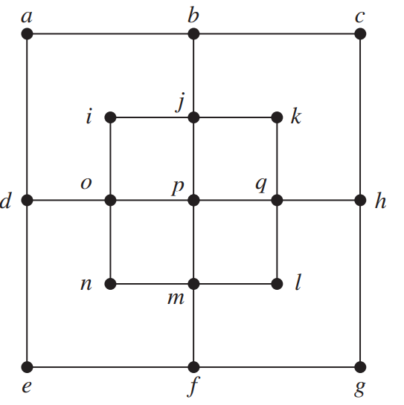
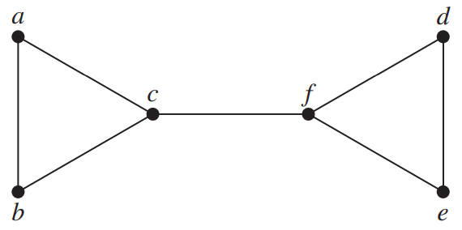
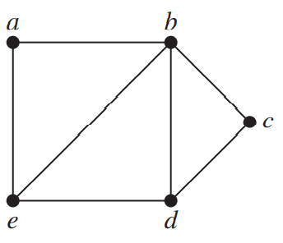
多选题
1分
Determine which of the given graphs have a Hamilton circuit.
a
b
A
a
c
B
b
C
c
提交
School of Computer Science, BUPT

Slide 51
Please feel free
to ask questions!
((( )))
School of Computer Science, BUPT

Slide 52
homework
§10.5
  8, 10, 16, 26, 34, 48
  58(optional)
School of Computer Science, BUPT

